Slide 1

Building Blocks of UML

Slide 2
What is UML?
A standardized, general purpose modeling language
Unified Modeling Language, which is mainly a collection of graphical notation that methods use to express the designs.
The UML is language for visualizing, specifying, constructing and documenting the artifacts of software system

Slide 3
Why Modeling..?
Models help us to visualize a system as it is or as we want it to be.
Models permit us to specify the structure or behavior of a system.
Models give us a template that guides us in constructing a system.
Models document the decisions we have made.

Slide 4
Why Models are needed?
Symptoms of inadequacy: the software crisis
  scheduled time and cost exceeded
  user expectations not met
  poor quality
Captures business processes
Enhance communication and ensures the right communication
Capability to capture the logical software architecture independent of the implementation language
Manages the complexity
Enables reuse of design

Slide 5
OOAD with UML
Building a house
Design and layout
Blueprint
Actual construction
Building software
OOAD
UML
Coding

Slide 6
A conceptual model of the UML
To understand the UML, you need to form a conceptual model of the language, and this requires learning three major elements:
The UML’s basic building blocks.
The rules that dictate how these building blocks put together.
Some mechanisms that apply throughout the UML.

Slide 7

Building Blocks of the UML:
Class
Interface
Collaboration
Use case
Active Classes
Components
Nodes
Structural
Behavioral
Grouping
Annotational
Things
Interaction
State Machine
UML Building Blocks
Relationships
Generalization
Dependency
Association
Realization
Packages
Notes
Object Diagram
Class Diagram
Sequence Diagram
Collaboration Diagram
State chart Diagram
Activity Diagram
Usecase Diagram
Component Diagram
Deployment Diagram
Diagrams

Slide 8
Views in UML
Component view
Logical view
Use Case view
Concurrency view
Deployment view

Slide 9
Building Blocks of UML
Things – abstractions that are first class citizen in a model
Relationships - tie things together
Diagrams - group interesting collections of things
Notes:
Abstraction – selective examination of certain aspects of a problem. The goal of abstraction is to isolate those aspects that are important and suppress those aspects that are unimportant.
Abstraction must always be for some purpose, because the purpose determines what is and is not important.
The purpose of abstraction is to limit the universe so that we can understand.

Slide 10
Things in the UML
There are four kinds of things in the UML:
  Structural things
  Behavioral things
  Grouping things
  Annotational things

Slide 11
Structural Things
Static part of a model, representing elements that are either conceptual or physical
  Classes
  Interfaces
  Collaborations
  Use cases
  Active classes
  Components
  Nodes

Slide 12
class
  a class is a description of a set of objects that share the same attributes, operations, relationships, and semantics
  A class implements one or more interfaces.
interface
  a collection of operations that specify a service of a class or component
  describes the externally visible behavior of that element
  defines a set of operation specifications but never a set of operation implementations
  attached to class or component that realizes the interface
Collaboration
  defines an interaction and is a society of roles and other elements that work together to provide some cooperative behavior
  Collaborations have structural, as well as behavioral dimensions
  A given class may participate in several collaborations
  therefore represent the implementation of patterns that make up a system

Slide 13

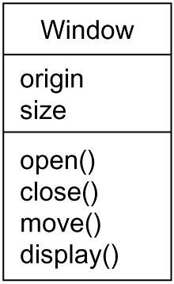
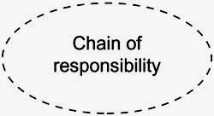
Class Name
Attributes
Figure 2: Interfaces
Operations
Figure 3: Collaborations
Figure 1: Classes

Slide 14
use case - a description of set of sequence of actions that a system performs that yields an observable result of value to a particular actor. A use case is used to structure the behavioral things in a model. A use case is realized by a collaboration.
active class - a class whose objects own one or more processes or threads and therefore can initiate control activity. An active class is just like a class except that its objects represent elements whose behavior is concurrent with other elements.
component - a physical and replaceable part of a system that conforms to and provides the realization of a set of interfaces. Represents the physical packaging of otherwise logical elements, such as classes, interfaces, and collaborations.
node - a physical element that exists at run time and represents a computational resource, having at least some memory and, often, processing capability. A set of components may reside on a node and may also migrate from node to node.

Slide 15
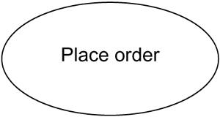
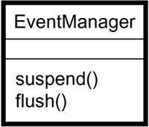
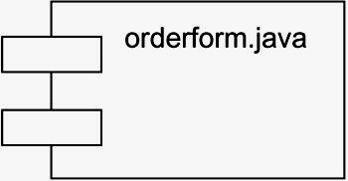
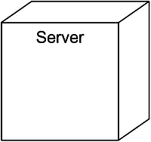
Figure 3: Use Cases
Figure 4: Active Classes
Figure 5: Components
Figure 6: Nodes

Slide 16
Behavioral Things
Behavioral things are the dynamic parts of UML models.
These are the verbs of a model, representing behavior over time and space.
Two primary kinds of behavioral things.
  Interaction (exchange of set of messages among a set of objects)(includes message, links, action sequence)
  State Machine (specifies the sequences of states an object or an interaction goes through during its lifetime in response to events, together with its responses to those events.)(includes states, transitions, events, activities)
    * Shown in the figure 7 and 8

Slide 17
Grouping Things
Grouping things are the organizational parts of UML models. These are the boxes into which a model can be decomposed.
There is one primary kind of grouping.
  Packages(mechanism for organizing elements into groups) (a package is purely conceptual meaning that it exists only at development time)
  * Shown in the figure 9

Slide 18
Annotational Things
Annotational things are the explanatory parts of UML models. These are the comments you may apply to describe, illuminate, and remark about any element in a model.
There is one primary kind of annotational things.
  Note (a symbol for rendering constraints and comments attached to an element or a collection of elements)
    * Shown in the figure 10

Slide 19
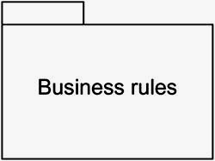

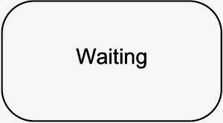
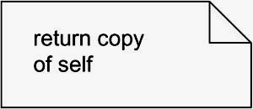
Figure 7: Messages
Figure 9: Packages
Figure 8: States
Figure 10: Notes

Slide 20
Relationships in the UML

Slide 21
Relationships in the UML
There are four kinds of relationships in the UML:
    Dependency (a semantic relationship between two things in which a change to one thing may affect the semantics of the other thing)
    2. Association (a structural relationship that describes a set of links, a link being a connection among objects)
    3. Generalization (a specialization / generalization relationship in which objects of the specialized element (the child) are substitutable for objects of the generalized element (the parent))
    4. Realization (a semantic relationship between classifiers, wherein one classifier specifies a contract that another classifier guarantees to carry out) (between interfaces and the classes or components and between use cases and the collaborations)

Slide 22




Relationships in the UML
1. Dependencies: rendered as a dashed line, possibly directed, and occasionally including a label
2. Associations: rendered as a solid line, possibly directed, occasionally including a label, and often containing other adornments, such as multiplicity and role names
3. Generalizations: rendered as a solid line with a hollow arrowhead pointing to the parent
4. Realization: rendered as a cross between a generalization and a dependency relationship

Slide 23
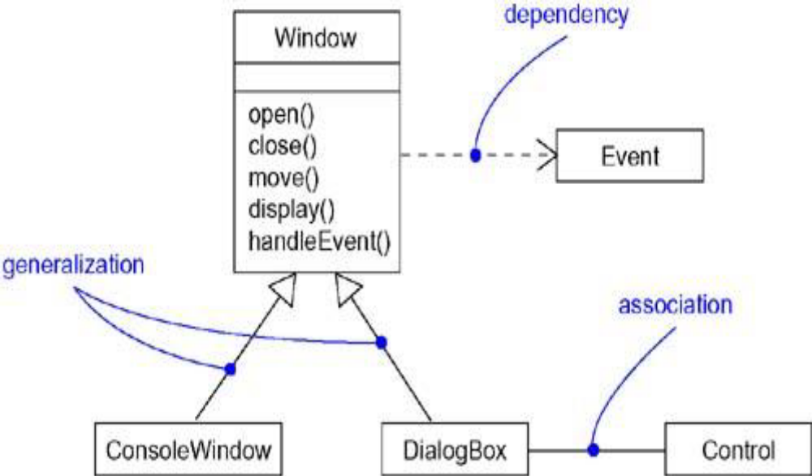
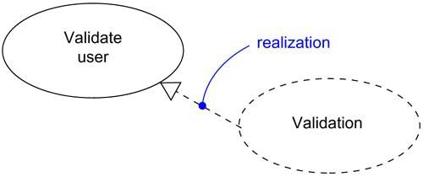
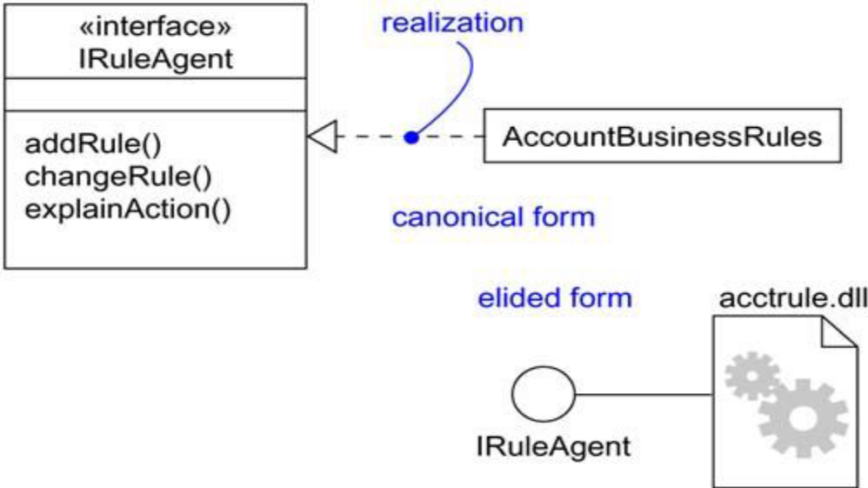

Slide 24
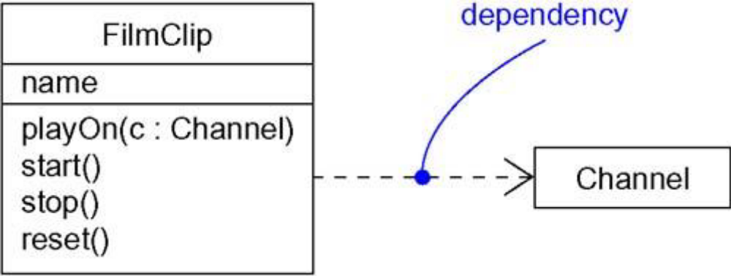
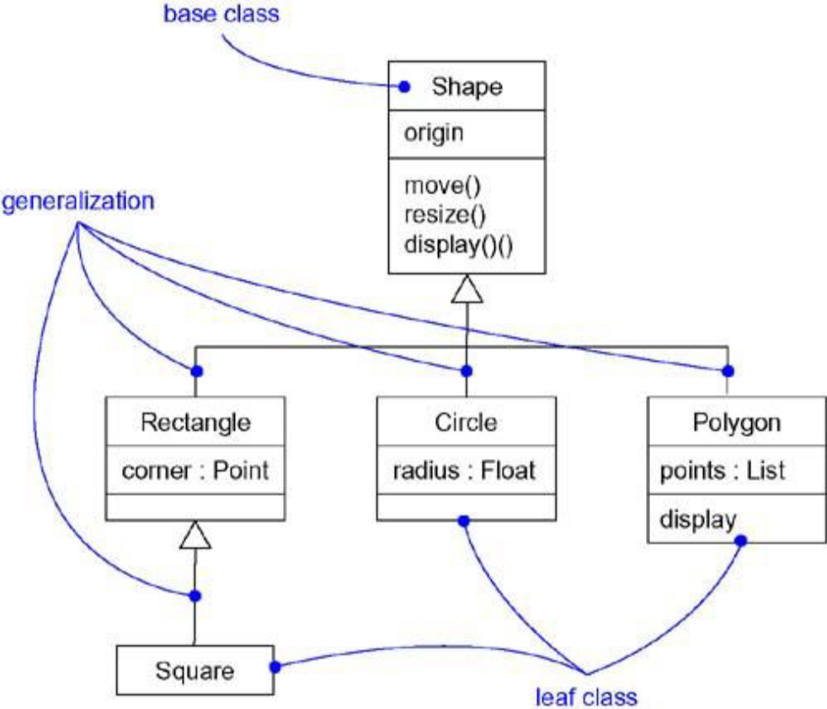
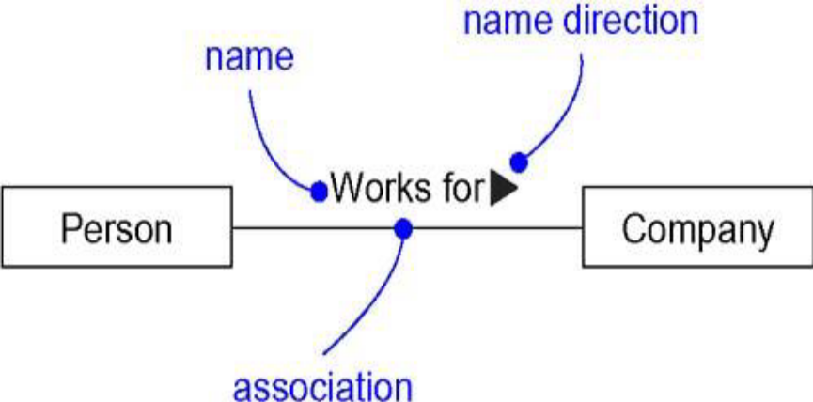

Slide 25
Diagrams in the UML
graphical presentation of a set of elements, rendered as a connected graph of vertices (things) and arcs (relationships).
a projection into a system
The same element may appear in all diagrams, only a few diagrams (the most common case), or in no diagrams at all (a very rare case)

Slide 26
Diagrams in the UML
1. Class diagram
2. Object diagram
3. Use case diagram
4. Sequence diagram
5. Collaboration diagram
6. Statechart diagram
7. Activity diagram
8. Component diagram
9. Deployment diagram
Interaction diagrams

Slide 27
1. Class Diagram
A class diagram shows a set of classes, interfaces, and collaborations and their relationships.
most common diagram found in modeling object-oriented systems.
address the static design view of a system.
Class diagrams that include active classes address the static process view of a system.

Slide 28
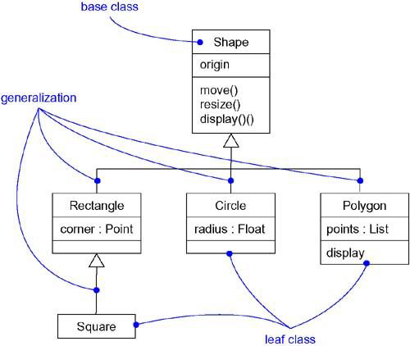

Slide 29
2. Object Diagram
An object diagram shows a set of objects and their relationships.
Object diagrams represent static snapshots of instances of the things found in class diagrams.
address the static design view or static process view of a system as do class diagrams, but from the perspective of real or prototypical cases.

Slide 30
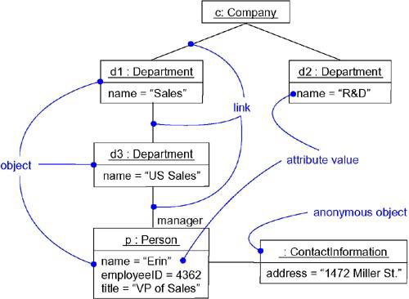

Slide 31
3. Use Case Diagram
A use case diagram shows a set of use cases and actors (a special kind of class) and their
relationships.
address the static use case view of a system.
especially important in organizing and modeling the behaviors of a system.

Slide 32
Interaction Diagrams
Both sequence diagrams and collaboration diagrams are kinds of interaction diagrams.
Arc shows an interaction, consisting of a set of objects and their relationships, including the messages that may be dispatched among them.
Interaction diagrams address the dynamic view of a system

Slide 33
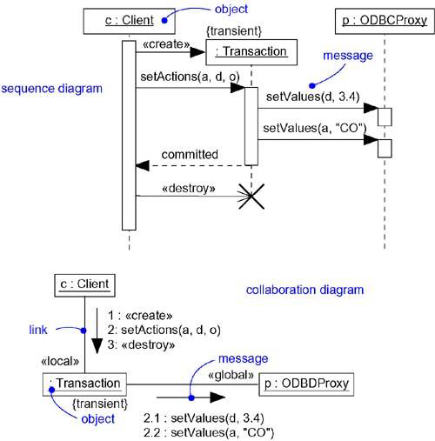

Slide 34
4. Sequence Diagram
A sequence diagram is an interaction diagram that emphasizes the time-ordering of messages.

Slide 35
5. Collaboration Diagram
collaboration diagram is an interaction diagram that emphasizes the structural organization of the objects that send and receive messages.
Note: Sequence diagrams and collaboration diagrams are isomorphic, meaning that you can take one and transform it into the other.

Slide 36
6. Statechart Diagram
A statechart diagram shows a state machine, consisting of states, transitions, events and activities.
Statechart diagrams address the dynamic view of a system.
especially important in modeling the behavior of an interface, class, or collaboration and emphasize the event-ordered behavior of an object, which is especially useful in modeling reactive systems.

Slide 37
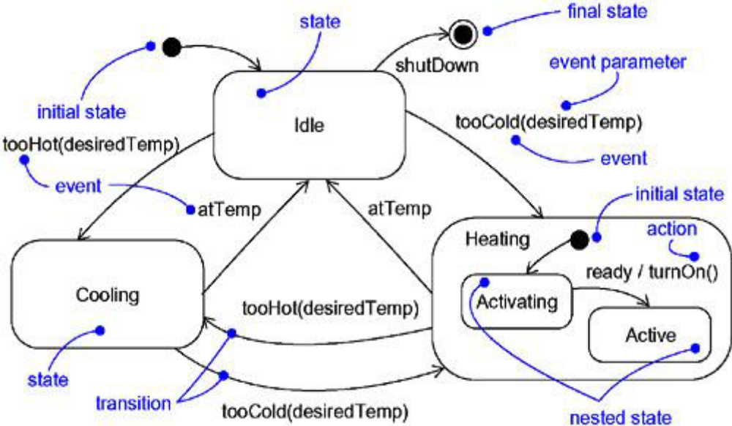

Slide 38
7. Activity Diagram
An activity diagram is a special kind of a statechart diagram that shows the flow from activity to activity within a system.
Activity diagrams address the dynamic view of a system.
They are especially important in modeling the function of a system and emphasize the flow of control among objects

Slide 39
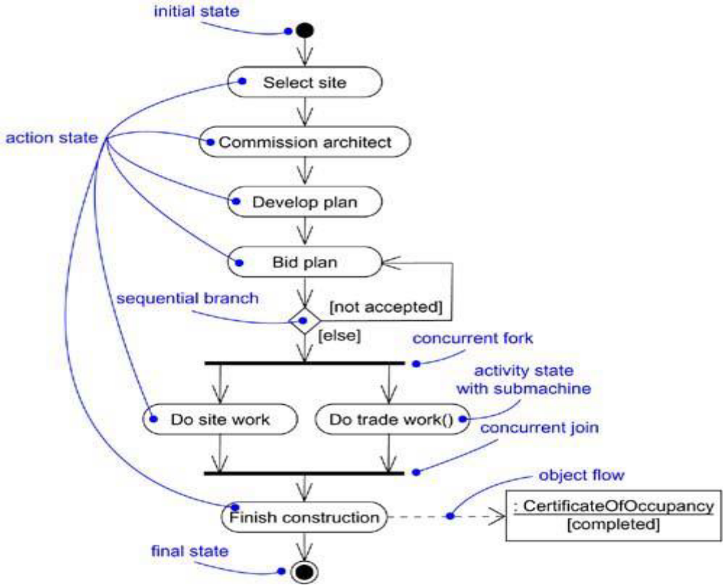

Slide 40
8. Component Diagram
A component diagram shows the organizations and dependencies among a set of components.
Component diagrams address the static implementation view of a system.
They are related to class diagrams in that a component typically maps to one or more classes, interfaces, or collaborations.

Slide 41
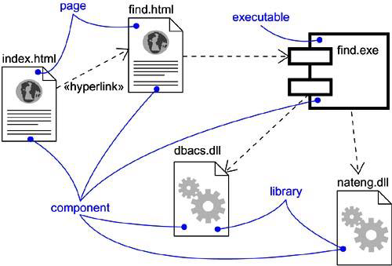

Slide 42
9. Deployment Diagram
A deployment diagram shows the configuration of run-time processing nodes and the components that live on them.
Deployment diagrams address the static deployment view of an architecture.
They are related to component diagrams in that a node typically encloses one or more components.

Slide 43
